Slide 1


Understanding users

Slide 2
Overview
What is cognition?
What are users good and bad at?
Mental models
External cognition
Using this understanding to inform system design

Slide 3
Why do we need to understand users?
Interacting with technology is cognitive
We need to take into account cognitive processes involved and cognitive limitations of users
We can provide knowledge about what users can and cannot be expected to do
Identify and explain the nature and causes of problems users encounter
Supply theories, modelling tools, guidance and methods that can lead to the design of better interactive products

Slide 4
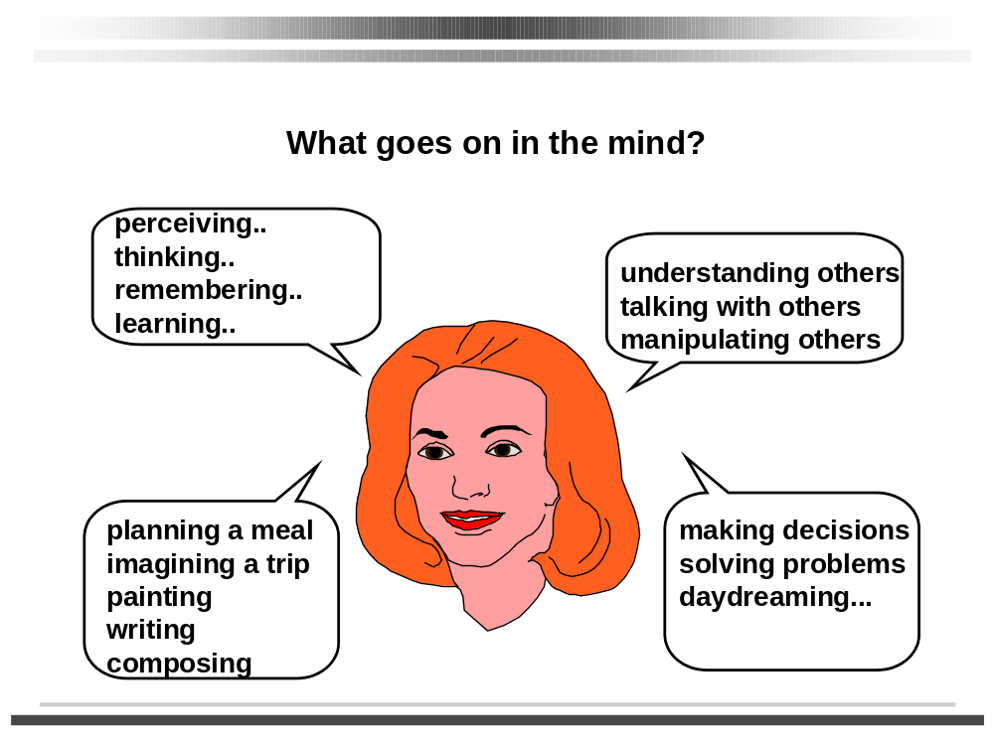
1. Bringing cognitive psychology knowledge to HCI

Slide 5
Core cognitive aspects
Attention
Perception and recognition
Memory
Reading, speaking and listening
Problem-solving, planning, reasoning and decision-making, learning
Here we focus on attention, perception & recognition, & memory

Slide 6
Attention
Selecting things to concentrate on from the mass around us, at a point in time
Focussed and divided attention enables us to be selective in terms of the mass of competing stimuli but limits our ability to keep track of all events
Information at the interface should be structured to capture users’ attention, e.g. use perceptual boundaries (windows), colour, reverse video, sound and flashing lights

Slide 7
Design implications for attention
Make information salient when it needs attending to
Use techniques that make things stand out like colour, ordering, spacing, underlining, sequencing and animation
Avoid cluttering the interface - follow the google.com example of crisp, simple design
Avoid using too much because the software allows it

Slide 8
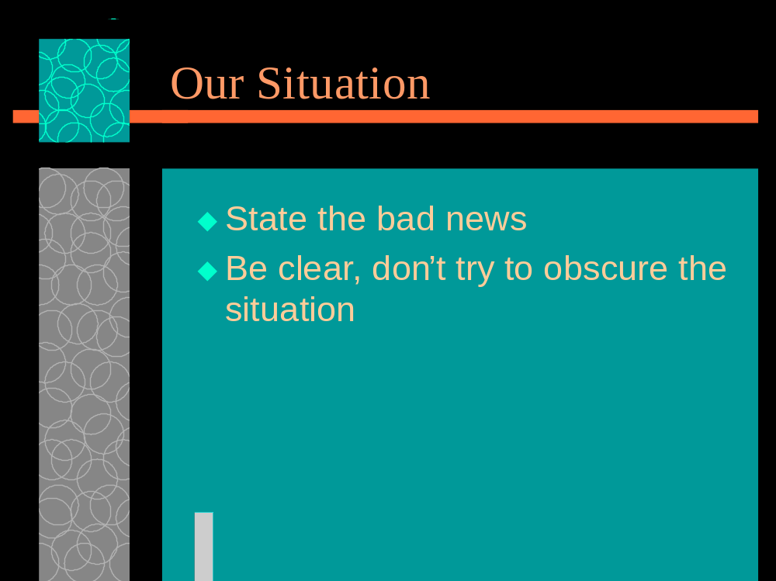
An example of over-use of graphics

Slide 9
Perception and recognition
How information is acquired from the world and transformed into experiences
Obvious implication is to design representations that are readily perceivable, e.g.
  Text should be legible
  Icons should be easy to distinguish and read

Slide 10

Which is easiest to read and why?
What is the time?
What is the time?
What is the time?
What is the time?
What is the time?

Slide 11
Memory
Involves encoding and recalling knowledge and acting appropriately
We don’t remember everything - involves filtering and processing
Context is important in affecting our memory
We recognize things much better than being able to recall things
  The rise of the GUI over command-based interfaces
Better at remembering images than words
  The use of icons rather than names

Slide 12
The problem with the classic ‘7±2’
George Miller’s theory of how much information people can remember
People’s immediate memory capacity is very limited
Many designers have been led to believe that this is useful finding for interaction design

Slide 13
What some designers get up to…
Present only 7 options on a menu
Display only 7 icons on a tool bar
Have no more than 7 bullets in a list
Place only 7 items on a pull down menu
Place only 7 tabs on the top of a website page
      But this is wrong? Why?

Slide 14
Why?
Inappropriate application of the theory
People can scan lists of bullets, tabs, menu items till they see the one they want
They don’t have to recall them from memory having only briefly heard or seen them
Sometimes a small number of items is good design
But it depends on task and available screen estate

Slide 15
More appropriate application of memory research
File management and retrieval is a real problem to most users
Research on information retrieval can be usefully applied
Memory involves 2 processes
  recall-directed and recognition-based scanning
File management systems should be designed to optimize both kinds of memory processes

Slide 16
File management
Facilitate existing memory strategies and try to assist users when they get stuck
Help users encode files in richer ways
  Provide them with ways of saving files using colour, flagging, image, flexible text, time stamping, etc

Slide 17
Mental models
Users develop an understanding of a system through learning & using it
Knowledge is often described as a mental model
  How to use the system (what to do next)
  What to do with unfamiliar systems or unexpected situations (how the system works)
People make inferences using mental models of how to carry out tasks

Slide 18
Mental models
Craik (1943) described mental models as internal constructions of some aspect of the external world enabling predictions to be made
Involves unconscious and conscious processes, where images and analogies are activated
Deep versus shallow models (e.g. how to drive a car and how it works)
Notes:
Questions on Craik

Slide 19
Everyday reasoning & mental models
You arrive home on a cold winter’s night to a cold house. How do you get the house to warm up as quickly as possible? Set the thermostat to be at its highest or to the desired temperature?
(b) You arrive home starving hungry. You look in the fridge and find all that is left is an uncooked pizza. You have an electric oven. Do you warm it up to 375 degrees first and then put it in (as specified by the instructions) or turn the oven up higher to try to warm it up quicker?

Slide 20
Heating up a room or oven that is thermostat-controlled
Many people have erroneous mental models (Kempton, 1996)
Why?
  General valve theory, where ‘more is more’ principle is generalised to different settings (e.g. gas pedal, gas cooker, tap, radio volume)
  Thermostats based on model of on-off switch model

Slide 21
Heating up a room or oven that is thermostat-controlled
Same is often true for understanding how interactive devices and computers work:
  Poor, often incomplete, easily confusable, based on inappropriate analogies and superstition (Norman, 1983)
  e.g. frozen cursor/screen - most people will bash all manner of keys

Slide 22
Exercise: ATMs
Write down how an ATM works
  How much money are you allowed to take out?
  What denominations?
  If you went to another machine and tried the same what would happen?
  What information is on the strip on your card? How is this used?
  What happens if you enter the wrong number?
  Why are there pauses between the steps of a transaction? What happens if you try to type during them?
  Why does the card stay inside the machine?
  Do you count the money? Why?

Slide 23
How did you fare?
Your mental model
  How accurate?
  How similar?
  How shallow?
Payne (1991) did a similar study and found that people frequently resort to analogies to explain how they work
People’s accounts greatly varied and were often ad hoc

Slide 24
External cognition
Concerned with explaining how we interact with external representations (e.g. maps, notes, diagrams)
What are the cognitive benefits and what processes involved
How they extend our cognition
What computer-based representations can we develop to help even more?

Slide 25
Externalizing to reduce memory load
Diaries, reminders,calendars, notes, shopping lists, to-do lists - written to remind us of what to do
Post-its, piles, marked emails - where placed indicates priority of what to do
External representations:
  Remind us that we need to do something (e.g. to buy something for mother’s day)
  Remind us of what to do (e.g. buy a card)
  Remind us when to do something (e.g. send a card by a certain date)

Slide 26
Computational offloading
When a tool is used in conjunction with an external representation to carry out a computation (e.g. pen and paper)
Try doing the two sums below (a) in your head, (b) on a piece of paper and c) with a calculator.
  234 x 456 =??
  CCXXXIIII x CCCCXXXXXVI = ???
Which is easiest and why? Both are identical sums

Slide 27
Annotation and cognitive tracing
Annotation involves modifying existing representations through making marks
  e.g. crossing off, ticking, underlining
Cognitive tracing involves externally manipulating items into different orders or structures
  e.g. playing scrabble, playing cards

Slide 28
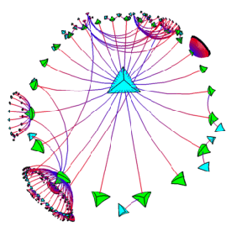
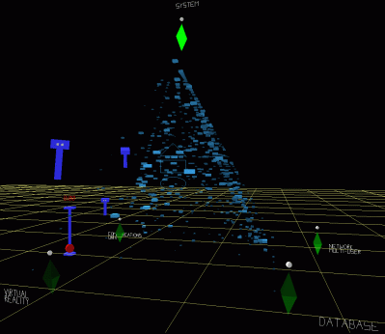
Design implication
Provide external representations at the interface that reduce memory load and facilitate computational offloading
e.g. Information visualizations have been designed to allow people to make sense and rapid decisions about masses of data

Slide 29
Informing design based on our understanding of users
How can we use knowledge about users to inform system design?
Provide guidance and tools
  Design principles and concepts
  Design rules
Provide analytic tools
  Methods for evaluating usability

Slide 30
Mental models & system design
Notion of mental models has been used as a basis for conceptual models
Assumption is that if you can understand how people develop mental models then can help them develop more appropriate mental models of system functionality
For example, a design principle is to try to make systems transparent so people can understand them better and know what to do

Slide 31
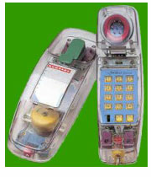
The design principle of transparency
• NOT to be understood as literal
• useful feedback
• easy to understand
• intuitive to use
• clear & easy to follow instructions
• appropriate online help
• context sensitive guidance of
how to proceed when stuck

Slide 32
Key points
Cognition involves many processes including attention, memory, perception and learning
The way an interface is designed can greatly affect how well users can perceive, attend, learn and remember how to do their tasks
The conceptual framework of ‘mental models’ and ‘external cognition’ provide ways of understanding how and why people interact with products, which can lead to thinking about how to design better products

